Slide 1
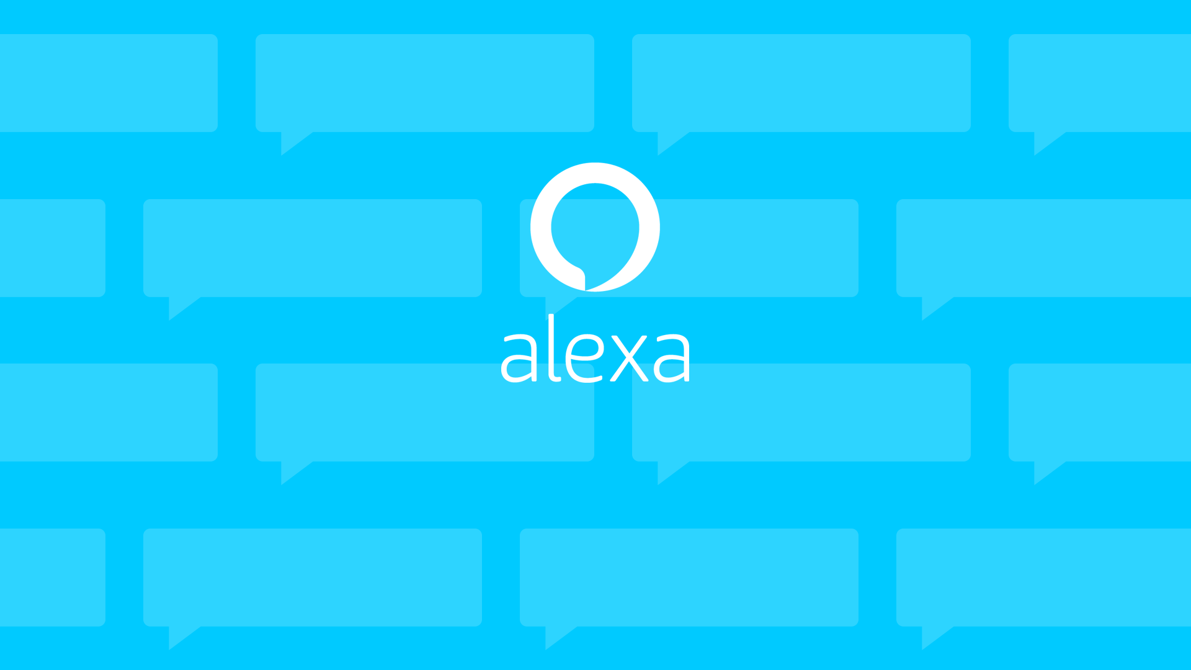
Submitted to :- prof Nidhi Nigam
Submitted by :- Narayan Punase
Enrollment no :- 0827CI201116
This Photo by Unknown Author is licensed under CC BY-SA

Slide 2
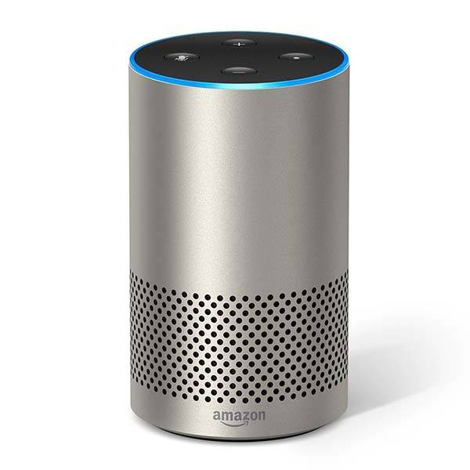
Introduction
Amazon Alexa, also known simply as Alexa, is a virtual assistant technology largely based on a Polish speech synthesizer named Ivona, bought by Amazon in 2013. It was first used in the Amazon Echo smart speaker and the
Echo Dot, Echo Studio and Amazon Tap speakers developed by
Amazon Lab126. It is capable of voice interaction, music playback,
making to-do lists, setting alarms, streaming podcasts, playing
audiobooks, and providing weather, traffic, sports, and other real-
time information, such as news. Alexa can also control several
smart devices using itself as a home automation system.
This Photo by Unknown Author is licensed under CC BY-SA-NC

Slide 3
How does Alexa work?
According to Adi Agashe, Program Manager at Microsoft, Alexa is built based on natural language processing (NLP), a procedure of converting speech into words, sounds, and ideas.
Amazon records your words. Indeed, interpreting sounds takes up a lot of computational power, the recording of your speech is sent to Amazon’s servers to be analyzed more efficiently.
Amazon breaks down your “orders” into individual sounds. It then consults a database containing various words’ pronunciations to find which words most closely correspond to the combination of individual sounds.
It then identifies important words to make sense of the tasks and carry out corresponding functions. For instance, if Alexa notices words like “sport” or “basketball”, it would open the sports app.

Slide 4
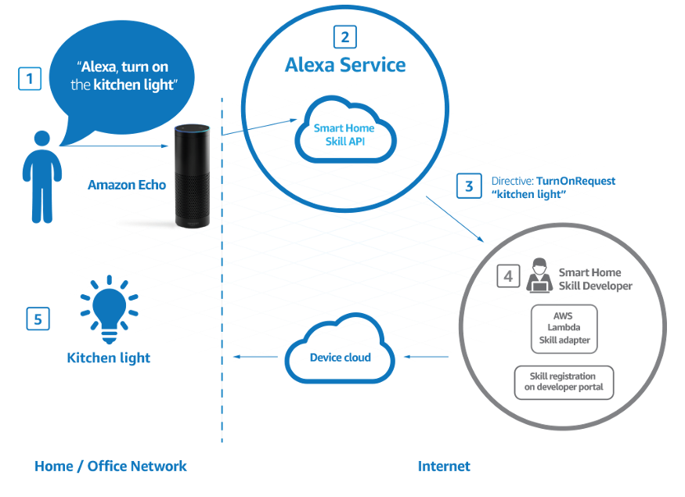

Slide 5
Alexa Skill Kit
The Alexa Skills Kit is a software development kit (SDK) that enables a developer to build skills, also called conversational applications, on the Amazon Alexa artificial intelligence assistant.
The Alexa Skills Kit is comprised of tools, application program interfaces (APIs), code samples and documentation that enables a developer to add skills to the 10,000-plus voice recognition capabilities available on Alexa.
Amazon Alexa is based in the Amazon Web Services (AWS) public cloud. A developer can upload Alexa skill code to AWS Lambda functions to execute code that is triggered by voice interactions. AWS automatically manages the compute resources for Lambda. A developer can certify, publish and update skills, which are made available through the Alexa Skills Store.

Slide 6
Alexa Skill Type
Smart Home Skills
Built-in interaction model
Alexa, turn on room's light
Alexa need permissions to retrieve device information and control device.
You need a cloud service to manage customers smart devices Skill must use AWS Lambda function.
Custom Skills
Build a skill with a custom interaction Model. This is a called custom.
Customer need to remember interaction name or invocation phrase.
Flash Briefing Skills
A flash briefing skill is the only way that you can provide content for a customer s flash briefing.
Pre-recorded audio clips and text-to-speech. This helps a customer choose your skill in the skill store.

Slide 7
Examples
"Alexa, wake me up at 7 in the morning“
"Alexa, what's on my calendar today?’
"Alexa, what's in the news?’
"Alexa, turn on all the lights.
"Alexa, play my Favourite playlist’
"Alexa, what's the weather in London?“
"Alexa, set the bedroom to 20 degrees"

Slide 8

Voiceflow Platform
Voice flow is a San Francisco-based company specializing in creating software for voice applications. The software is in the form of a platform where individuals or businesses can build voice applications without needing to know how to code. The voice applications can act as chat bots for the user's company. Voice flow has been used in industries such as education, hospitality, electronics sales, and marketing.
The platform allows for users to design, prototype and launch voice applications for Amazon Alexa and Google Assistant. The applications are constructed using production-ready code where users can go on the Voice flow platform and drag and drop "blocks" of the pre-made code to make their own custom voice app. The apps can be tested on the platform as well.

Slide 9
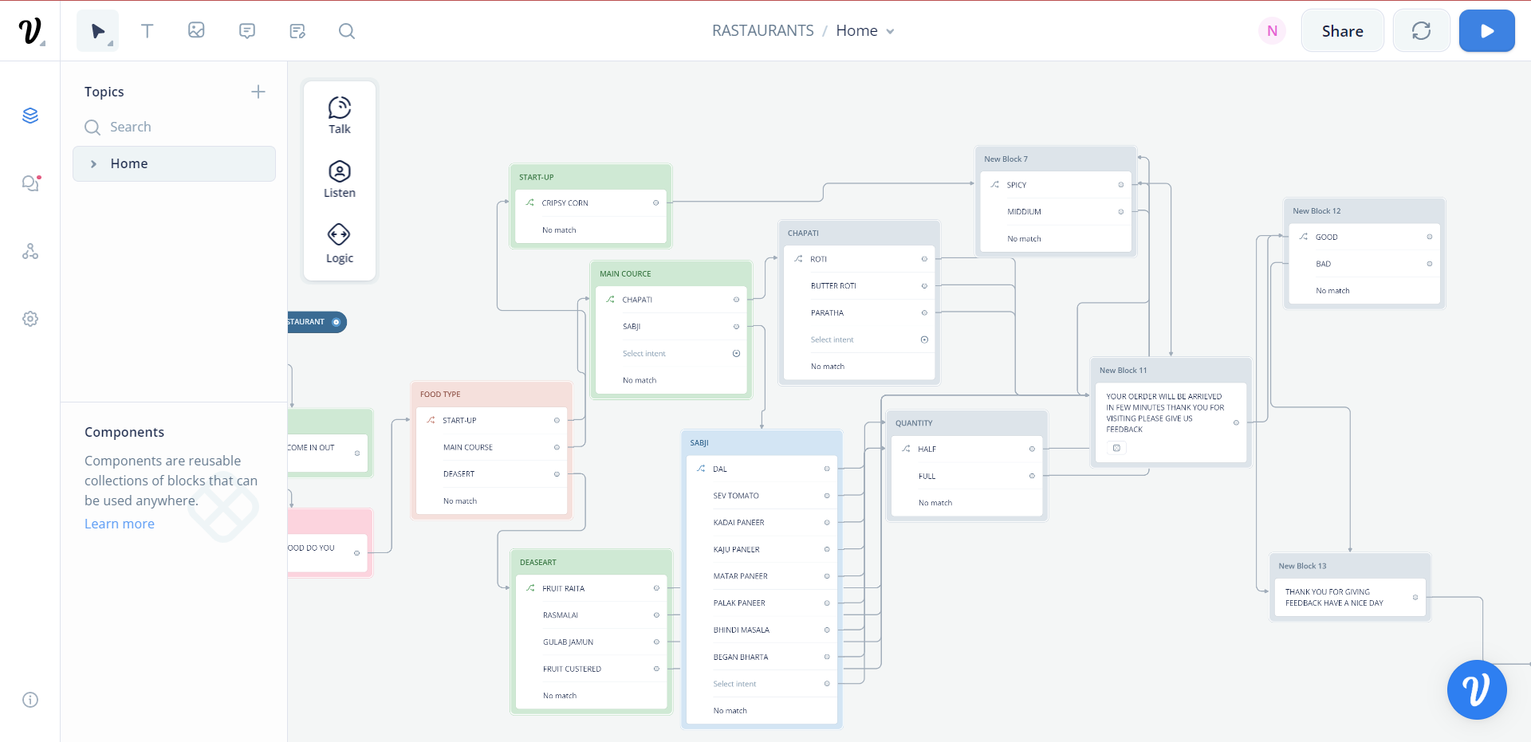
Voiceflow interface

